Slide 1



FactFinder
Justice League
Introduction
Problem Statement
Persona
Technologies
Team
Agreement
Retrospective
Project
Schedule
Project Description

Slide 2
Agenda
Team Introduction
Improvements from professor feed back
Project Description
Team working agreement
Personas
Minimum Valuable Product
Technologies and Algorithms
Diagrams
Architecture diagrams
Sequence diagrams
ER Diagram
Class Diagram
Sprint 3 Recap
Product Backlog
Sprint Summary
Sprint 4 Backlog
Test Cases
Metrics
Velocity Report
Burn Down Chart
Retrospective
Project Demo
App Screenshots
API Screenshots
Live application demo

Slide 3







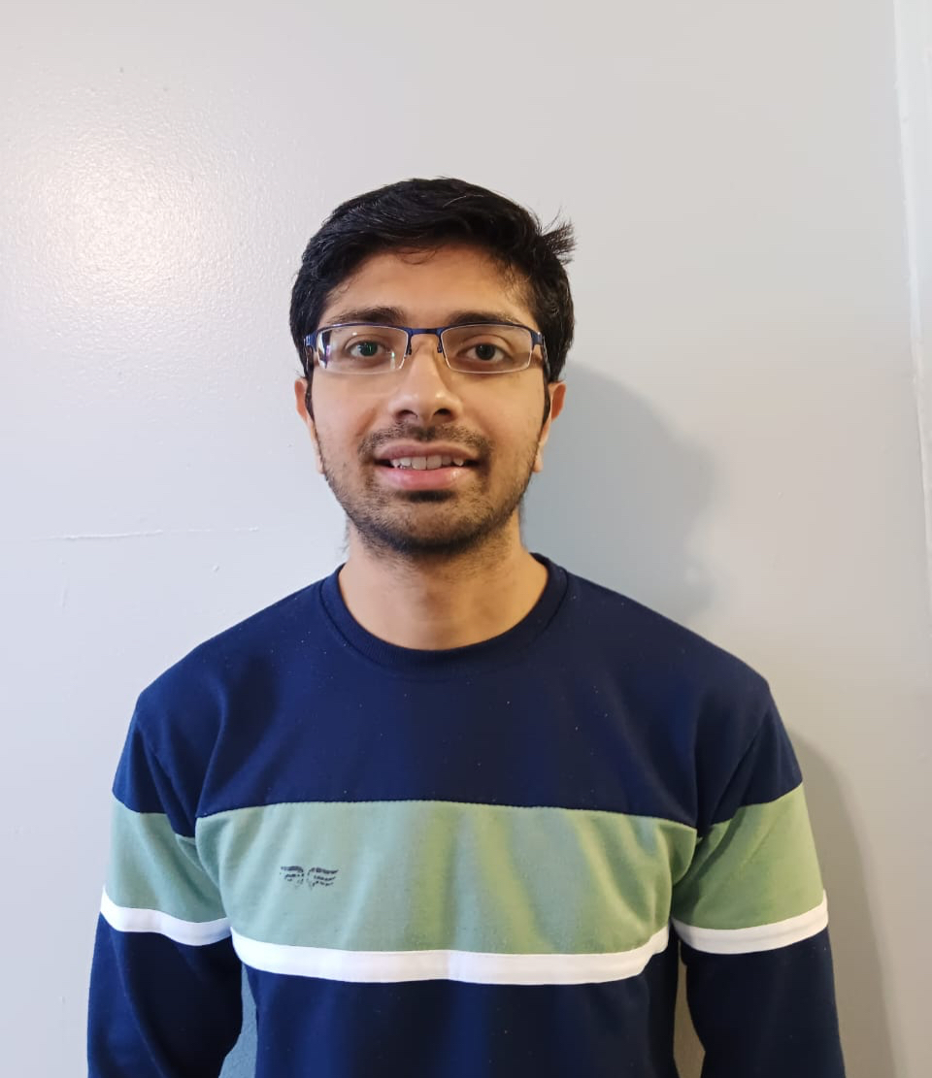
Meet our team
Suraj Salunke
Manthan Kale
Quality Analyst & Developer
Scrum Master & Developer
Kavita Kamtekar
Saurabh Chaudhary
Full Stack Developer
Product Manager & Developer
Gayatri Kulkarni
Maheswari Vidyadharani
Developer
Developer
Sai Kumar Tata
Rushabh Shingala
Developer & Desigining
Developer & Desigining

Slide 4
Improvements made from Professor Feedback
Updated User stories for product backlog
Explained Technologies & Algorithms with details.
Included Class Diagram
Improved Team velocity report
Included Story point estimation to user stories
Included Status of test cases
Improved Live application demo

Slide 5
Project Description
Fact Finder is a web app designed to combat online misinformation by differentiating between fake and real news. Additionally, it can create a summary of the news.
For anyone concerned about online misinformation and facing time constraints for reading news articles.
who upload the news article the Fact Finder web app is a web app that use machine learning and deep learning algorithms that can detect misinformation.
Unlike believe any information on internet.
Our application verifies the authenticity of information and saves time by creating summaries of articles.
Benefit Outcomes:
• Ensuring the authenticity of the information.
• Saves valuable time by generating summaries of the articles.
• Contributes to the fight against misinformation.

Slide 6
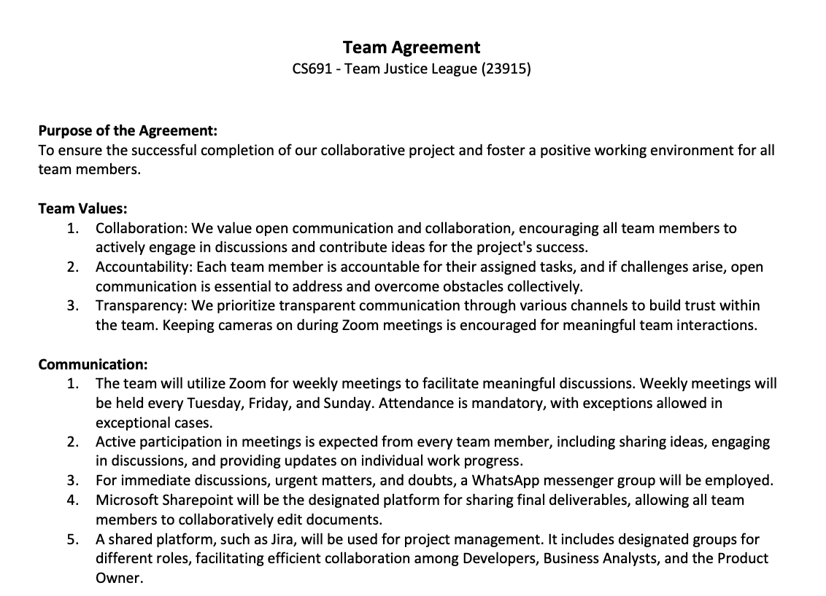
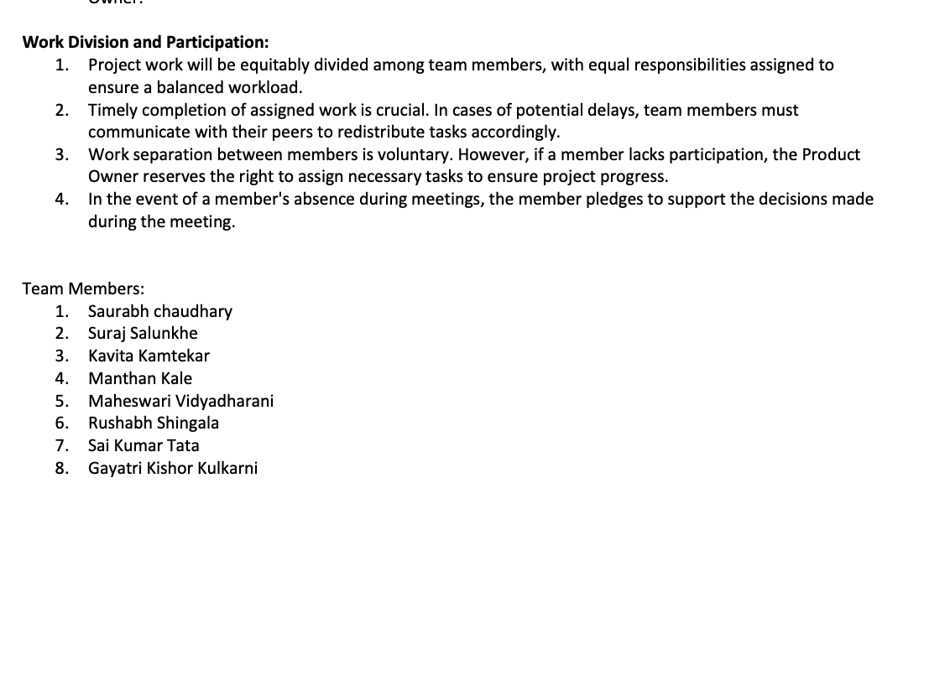
Team working agreement

Slide 7

Personas
Background: Maria is a community activist working on social justice issues. She recognizes the role of misinformation in shaping public opinion and wants to combat false narratives that may undermine her advocacy efforts. Maria is motivated to use the web application as a tool to verify information before sharing it within her community.
Age: 35
Occupation: Community Activist
Goals and Motivation: Maria's goal is to empower her community with reliable information. By leveraging the web application, she aims to strengthen the credibility of her advocacy work, foster informed discussions, and counteract misinformation that may be used to undermine social justice causes

Slide 8

Personas
Background: David owns a small business that heavily relies on its online presence for customer engagement. He's concerned about potential misinformation impacting the reputation of his business. The web application is crucial for David to verify news and updates related to his industry.
Age: 38
Occupation: Small Business Owner
Goals and Motivation: David's primary goal is to safeguard his business's reputation. By using the web application, he aims to prevent the spread of false information that could harm customer trust and loyalty. His motivation is to maintain transparency and integrity in his business communications.

Slide 9

Personas
Background: Michelle is a fitness and health enthusiast who frequently relies on online health-related information. With the abundance of health-related news articles and social media posts, Michelle often encounters conflicting information. The web application is valuable for him to discern between credible and misleading health information.
Age: 31
Occupation: Fitness Trainer
Goals and Motivation: Michelle's primary goal is to maintain a healthy lifestyle and share accurate health advice with her followers. By using the web application, he aims to avoid the spread of misinformation in the fitness and health community, contributing to a more informed and health-conscious online environment.

Slide 10
1) The user will also be able to check news without having account in FactFinder unless user wants to check his search News History. 2) The "Homepage" tab will display a short video of what the Fake news is. 3) The user should navigate to "Verify News" tab and post news as a text in the Textbox. 4)The user can click summarize Button to create the summary of the News Articles. 5) The user will click on verify news button or summary button. 6) The system will then generate a response based on our ML model. 7) The user will be able to get a response if the news/text posted was Fake or Real. 8) The "About us" tab will display explanation of the website, what it does and how it works. 9)The "Team" tab will display explanation of each team member of the factfinder. 10) The user can Register with email-ID and password and user should able to click on submit button to get registered successfully. 11) The user should Login with email-ID and password. 12) After Login, user should see TABS such as Verify News ,Blog , Search History, and a Chat etc. 13) The user can click on Blog tab and post any latest news or facts for extra information for people. 14)User can comment on a particular blog and give there own opinions. 15)Users can click on chat tab and chat with like-minded people to discuss about any latest news for more information.
MVP(Minimum Valuable Product):

Slide 11
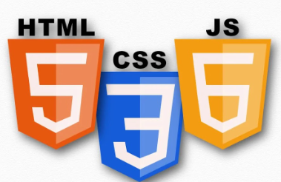
Technologies
For Front-End Development :
1.JavaScript:
JavaScript is an object-oriented programming language primarily used for creating interactive and dynamic web application. Main functionalities of JS are client-side scripting meaning it can run on user's web browser rather than on web server which is very helpful for dynamic web pages. It can interact with DOM(Document Object Model) of a web page, we can manipulate DOM using JS like adding events, button clicks, keyboard inputs, form submissions. It also supports asynchronous programming using callbacks, promises and await features. JS supports all major web browsers making it universal language for web development. And lastly it can support many frameworks and libraries such as React.js, Angular, Node.js and many more.

Slide 12
Technologies(Cont..)
For Front-End Development :
2.HTML5:
Hypertext Markup Language 5 or HTML5 is the latest version of the standard markup language used to create web pages and applications. HTML5 introduces many new features like, Semantic markup such as header, footer, nav, article, section and aside which improved overall structure and accessibility of web content. HTML5 also supports audio and video elements. The canvas element is used for 2D graphics and animations directly in web browser.
3.CSS:
CSS is a stylesheet language used for styling the HTML and XML documents.

Slide 13

Technologies(Cont..)
For Back-end Development
Python :
Python is an Object-Oriented high-level language known for its simplicity, readability and versatility. Its syntax is designed to be clear and readable very much like the English language. Python is one of the popular programming languages for Machine learning. It has so many libraries and frameworks specifically designed for ML and deep learning like
NumPy: It provides the foundation for many other libraries in the python scientific computing ecosystem, it supports multidimensional arrays and matrices.
Pandas: It is the most useful data manipulation library which provides data structures like data frames and series. While working on the back-end code for our project we used DataFrame. We import the training data which was in csv format as a Data Frame.
Scikit-learn: It is a ML library which is ideal for data mining and analysis, it many algorithms for classification, regression, clustering and model evaluation. For the classification of our data frame, we used logistic regression from sklearn.linear_model. To train the model we need to split the data which we done using sklearn.model_selection. And to get the accuracy report and classification report of the model we used the sklearn.metrics.
TensorFlow and PyTorch: These deep learning frameworks are the main tools to build and train neural networks for many ML tasks, we used these libraries for natural language processing for our project. For our project we created a RNN Neural network using tensorflow.keras.models

Slide 14

Technologies(Cont...)
Frameworks and Libraries
1.Flask : It is a lightweight and flexible web framework for python, ideal for building web applications. Flask is often referred to as a microframework because it provides the essentials for building web applications without imposing strict rules or dependencies. Flask uses a simple and intuitive routing system to map URLs to Python functions. For our application we used three end-points as routing system.
app = Flask(__name__)
@app.route('/process', methods=['POST'])
@app.route('/summarize', methods = ['POST'])
@app.route('/', methods = ['POST'])
Flask includes a built-in template engine called Jinja2, which allows anyone to generate HTML content dynamically by combining templates with data from Python code. It includes support for managing user sessions and implementing authentication and authorization mechanisms.

Slide 15

Technologies(Cont...)
Frameworks and Libraries
2.React : React is a JavaScript library for building user interfaces, particularly single-page applications that require dynamic and interactive UI. It uses component-based architecture in which UIs are divided into reusable components. React uses virtual DOM to maintain the UI hierarchy any change in UI first apply to virtual DOM and then reconciled with actual DOM resulting minimal updates in the code. It introduced JavaScript XML syntax extension which allow to write HTML like code within the JS.

Slide 16

Technologies(Cont...)
Database
1.Firebase :
Firebase Realtime Database is a cloud-hosted NoSQL database. It is provided by Google as part of the Firebase platform. It allows developers to store and synchronize data in real-time between clients and servers which enable the development of responsive and collaborative web and mobile applications. It uses JSON data model to stored structured data. It support built-in offline data

Slide 17
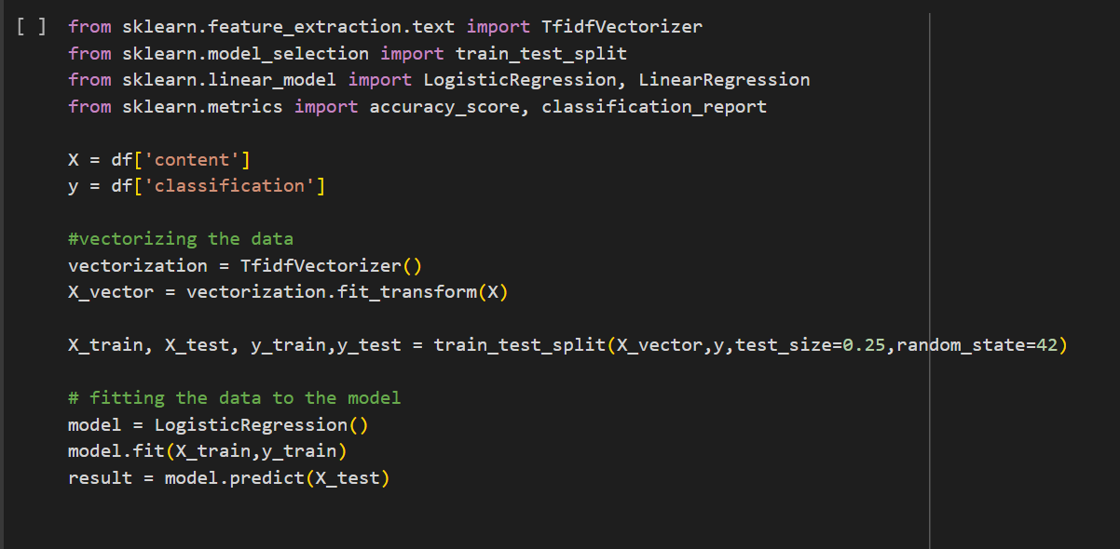
Algorithms
Machine Learning Algorithms (scikit-Learn) : Scikit-learn is a powerful and widely used open-source ML library for Python. It has many supervised and unsupervised learning algorithms, data preprocessing, feature selection and model evaluation.
We used supervised learning called logistic regression for our project using sklearn.linear_model.
We split our data using model_selection.

Slide 18
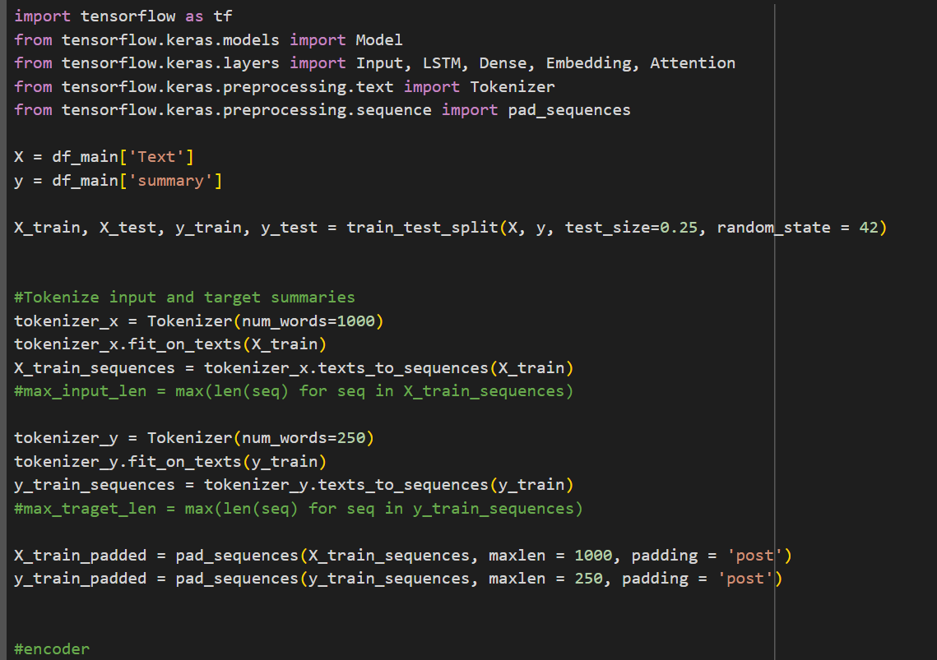
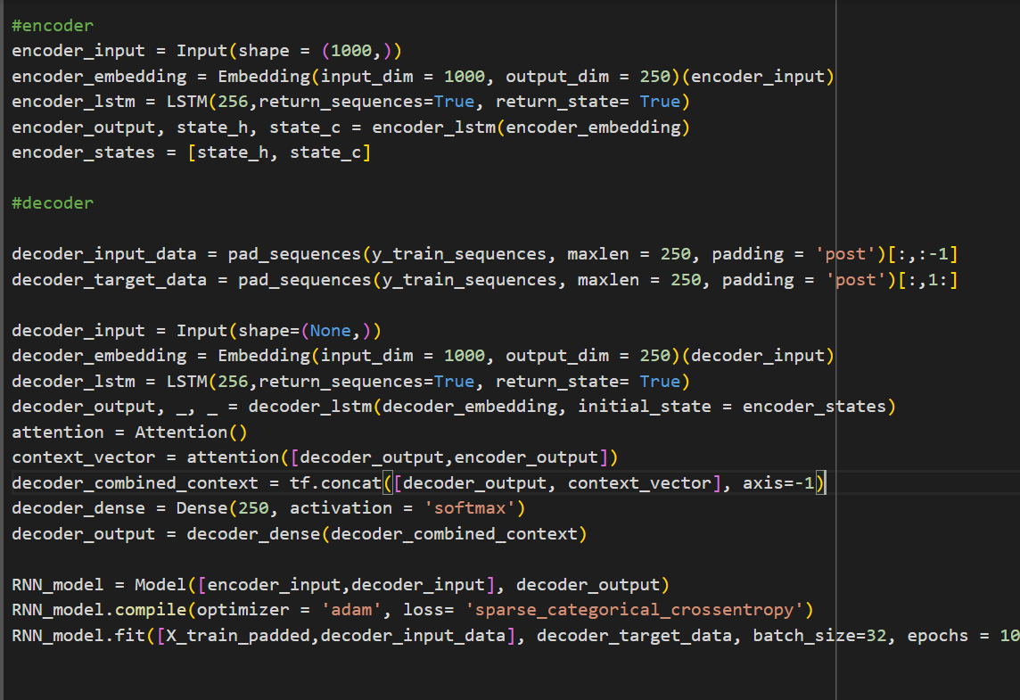
Algorithms(cont..)
Recurrent Neural Network(RNN): RNN is a high-level neural network from keras API. It is a class of NN designed for processing sequential data. RNNs have loops within their architecture, allowing them to maintain information across time steps. To generate summary from a news article LSTM type of RNN is ideal and we used for our project.

Slide 19
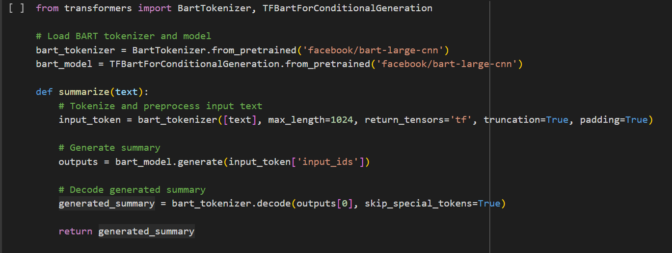
Algorithms(cont..)
We also used Bidirectional and auto-regressive transformers(BART) neural network which is introduced by Facebook AI. Unlike traditional models like GPT, BART incorporates bidirectional information flow. This allows BART to capture bidirectional context and improve performance on tasks like text generation and completion.

Slide 20
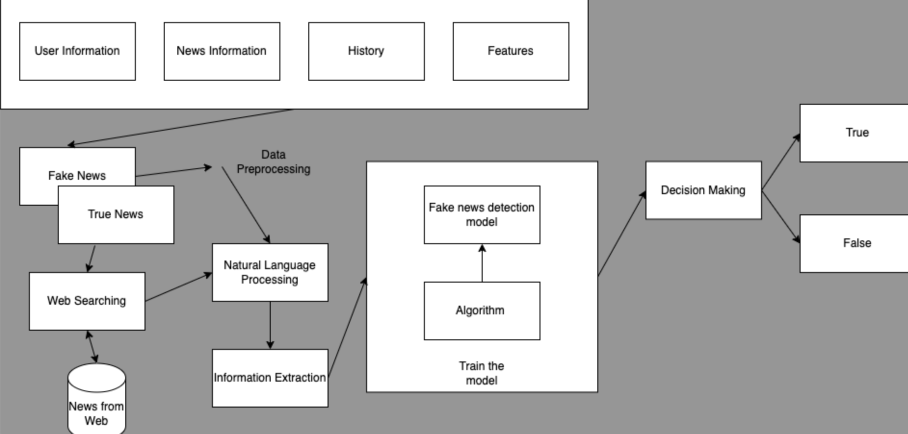
Architecture Diagram

Slide 21
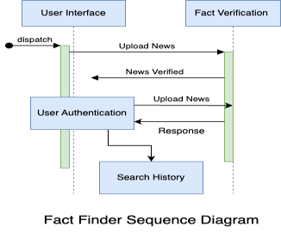
Sequence Diagram

Slide 22
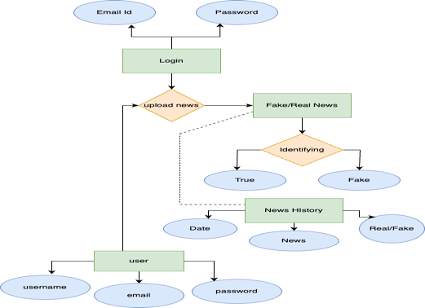
Entity-Relation Diagram:

Slide 23
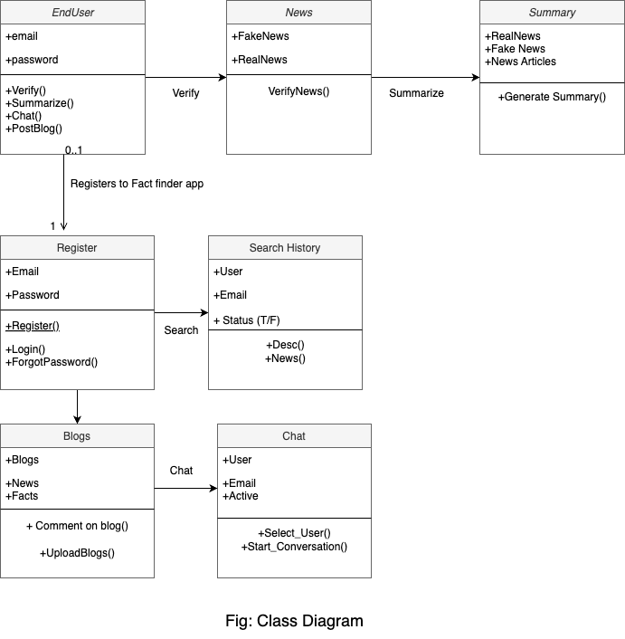

Slide 24
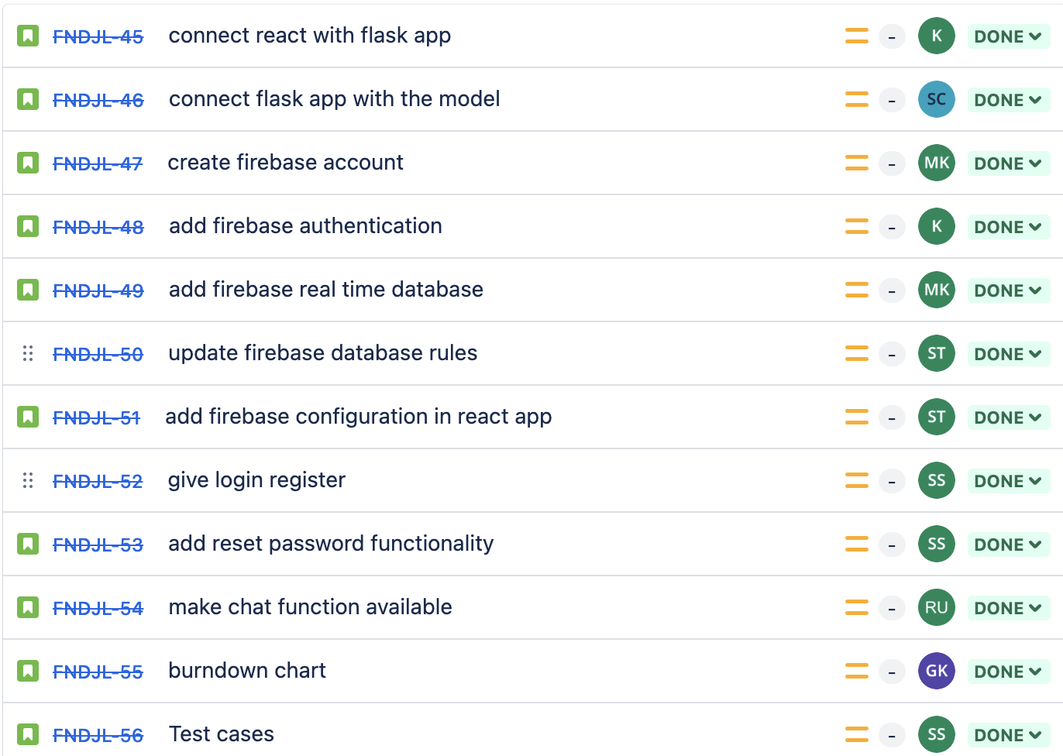
Sprint 3 Recap

Slide 25
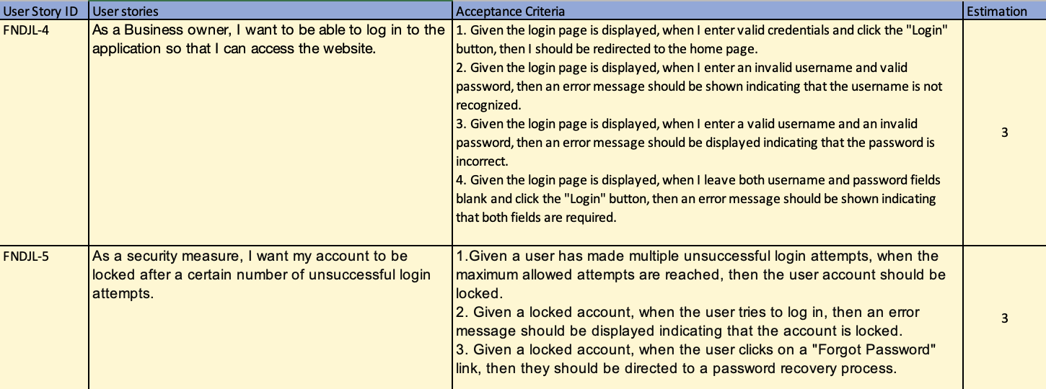
Product Backlog

Slide 26
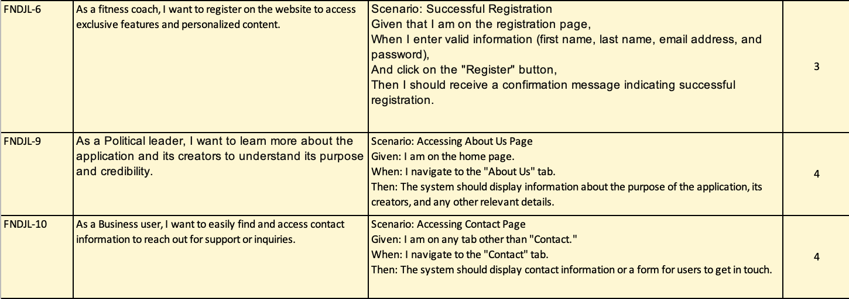
Product Backlog

Slide 27
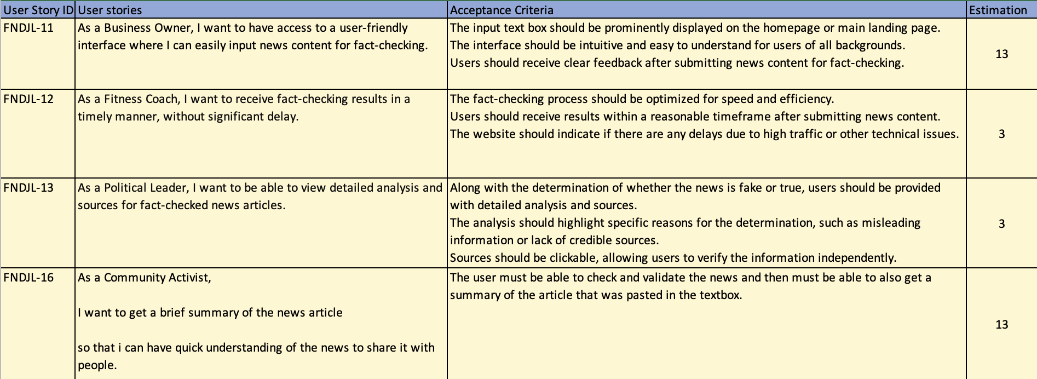
Product Backlog

Slide 28
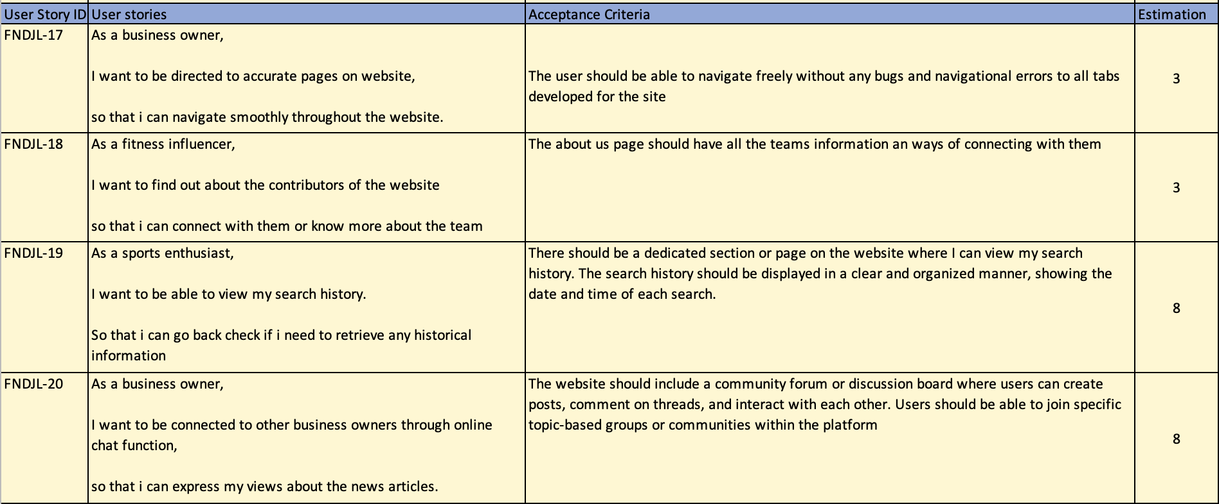
Product Backlog

Slide 29
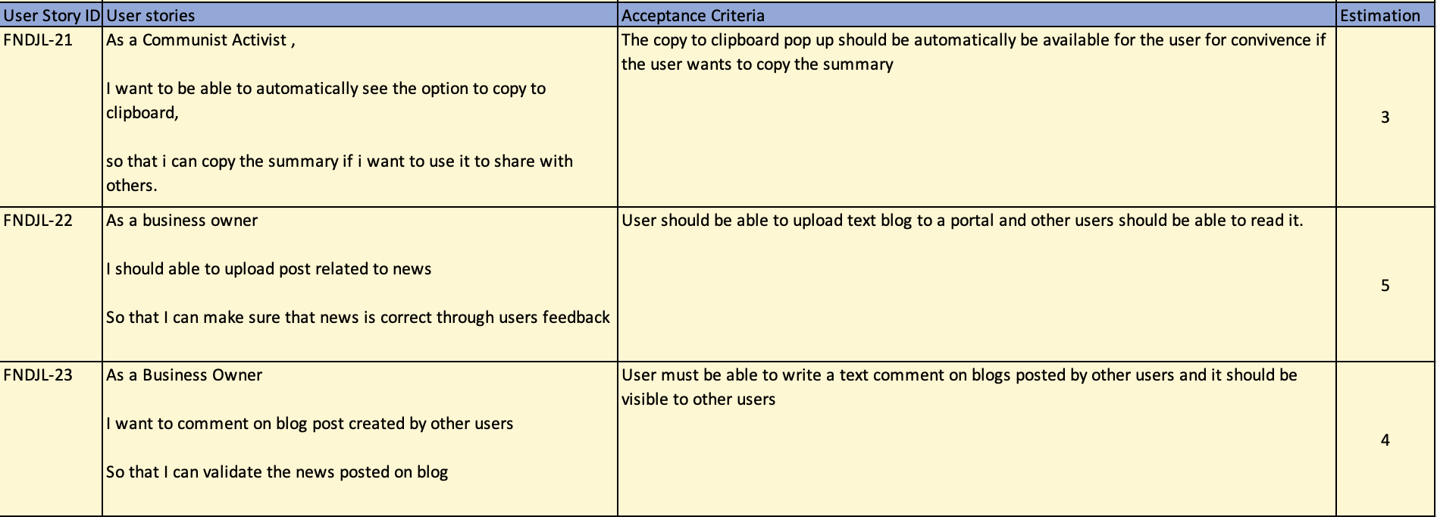
Product Backlog

Slide 30
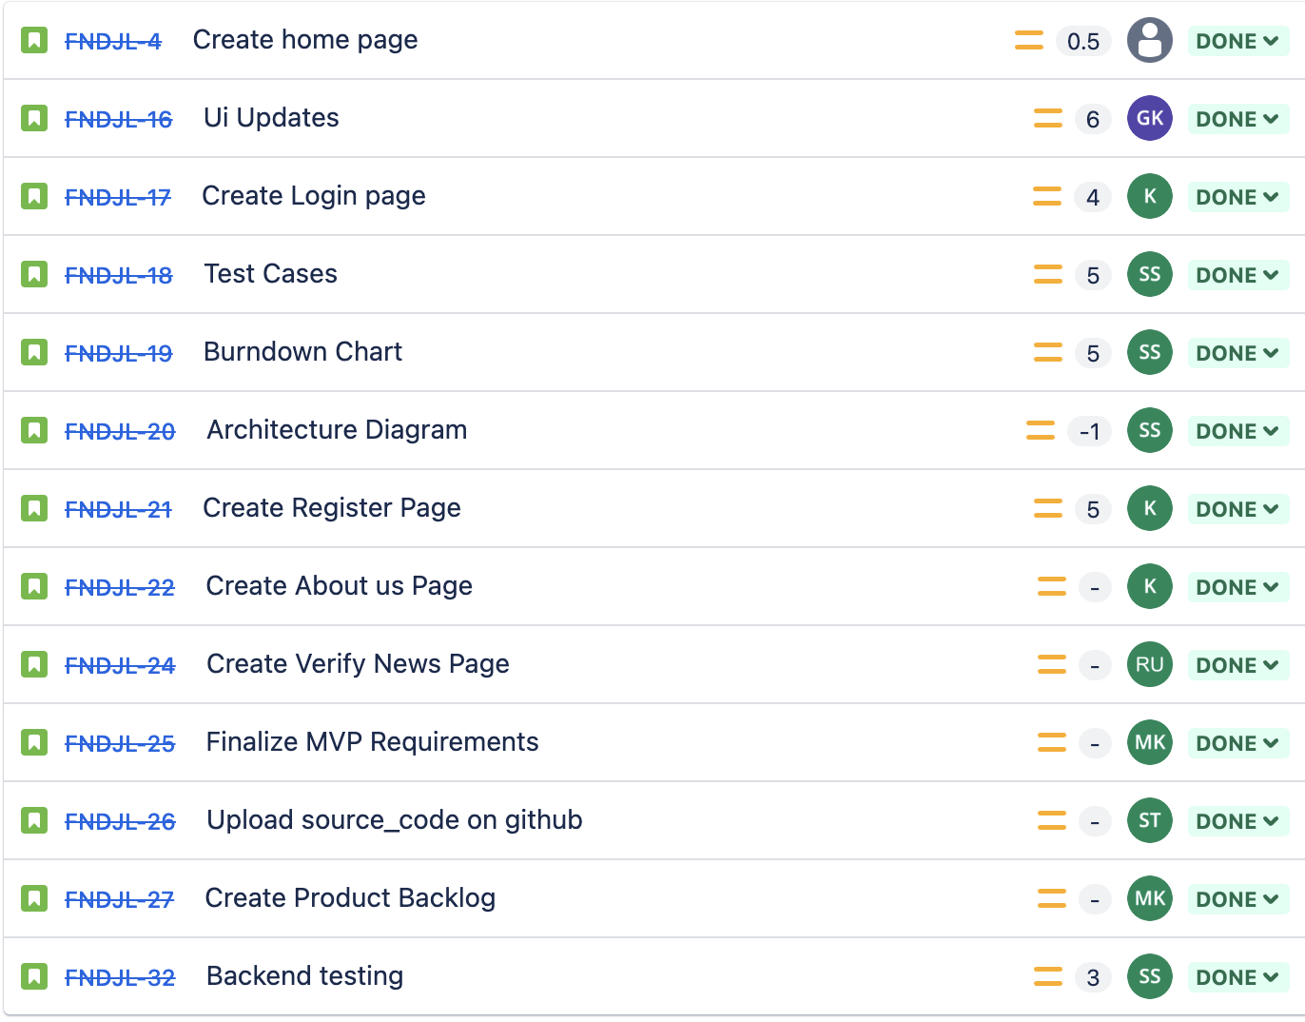
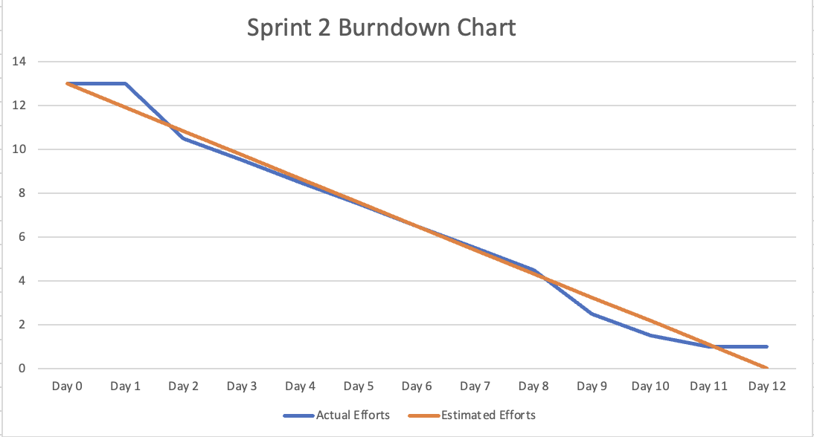
Sprint 2 Summary

Slide 31
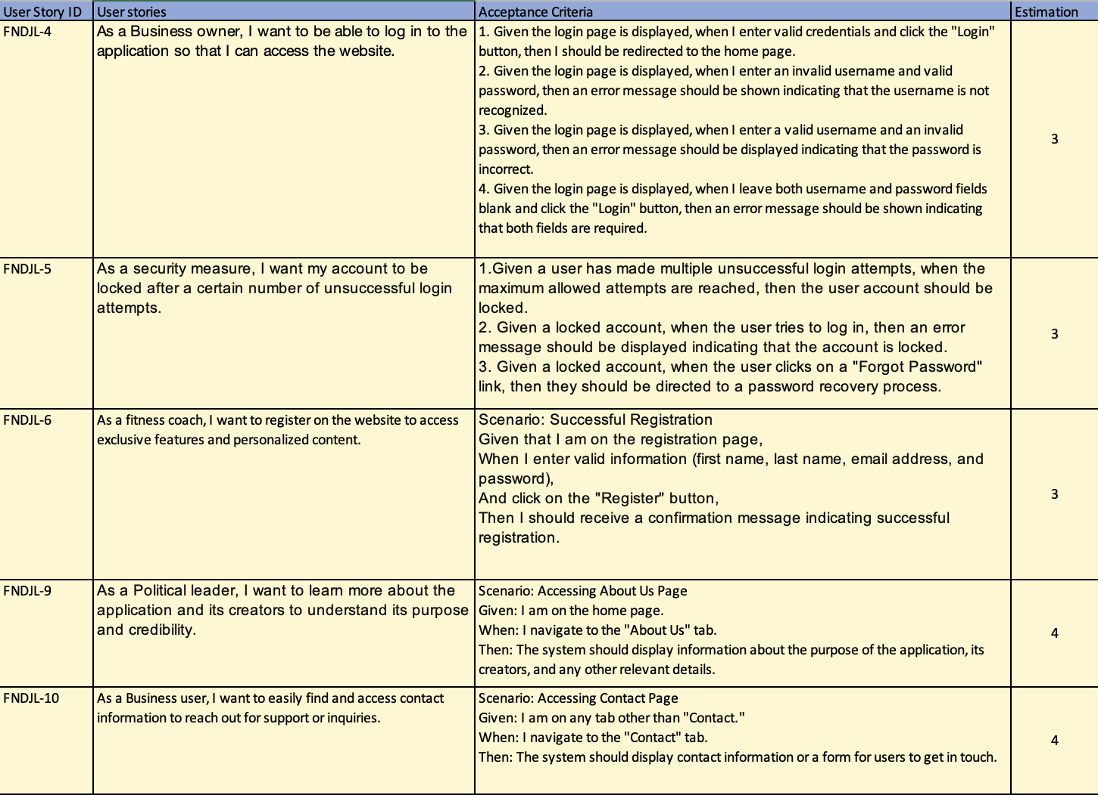
Sprint 2 Summary

Slide 32
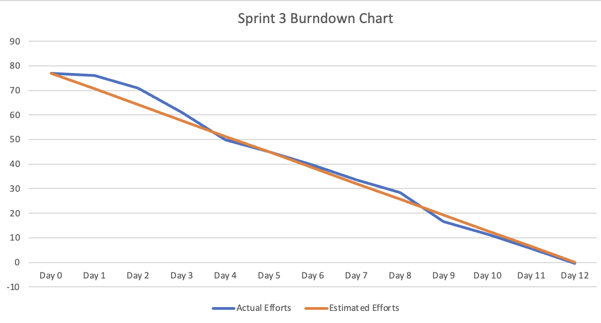
Sprint 3 Summary

Slide 33
Sprint 3 Summary

Slide 34
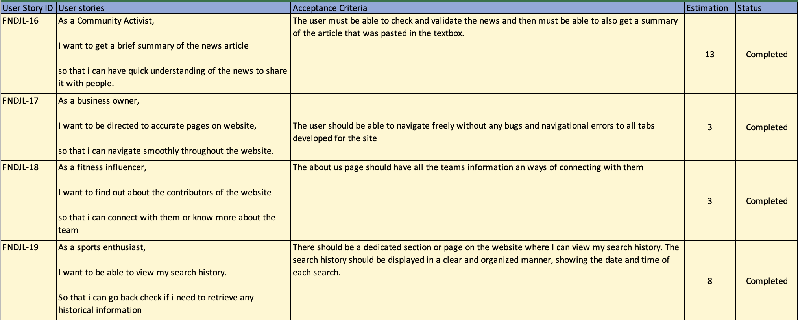
Sprint 4 backlog

Slide 35
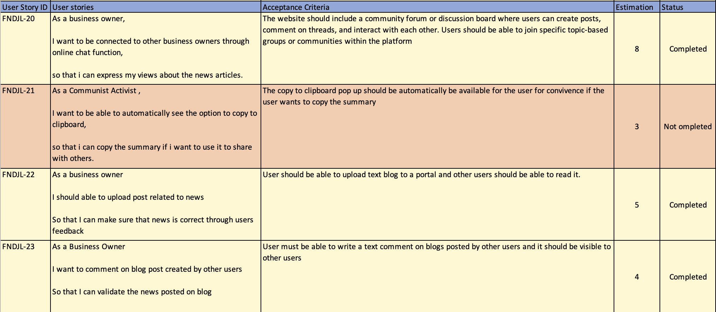
Sprint 4 backlog with status

Slide 36
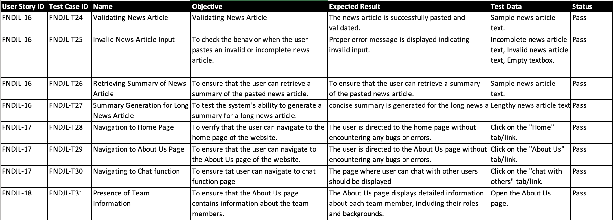
Test Cases

Slide 37
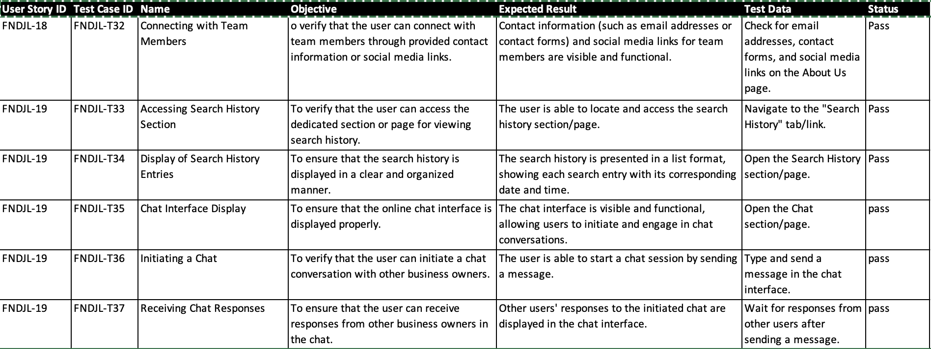
Test Cases

Slide 38
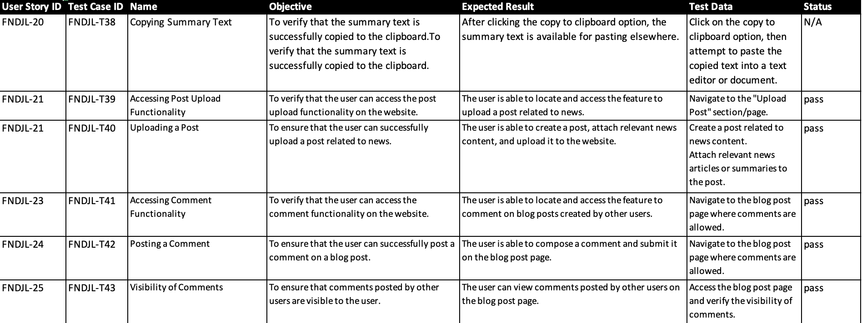
Test Cases

Slide 39

Metrics

Slide 40
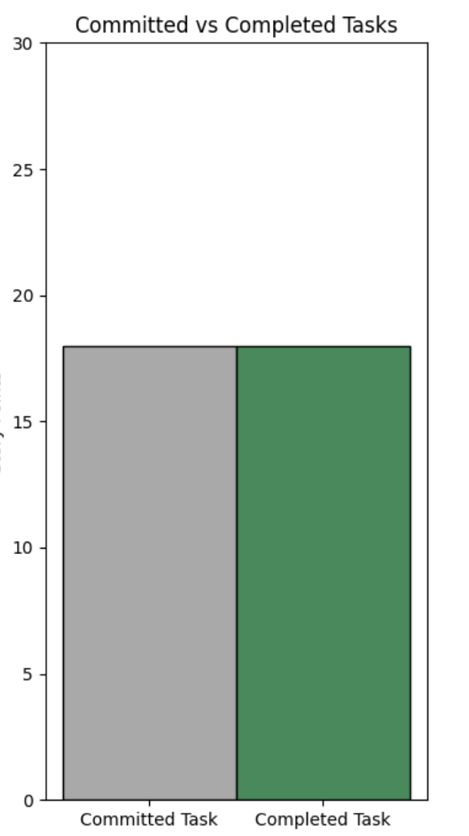
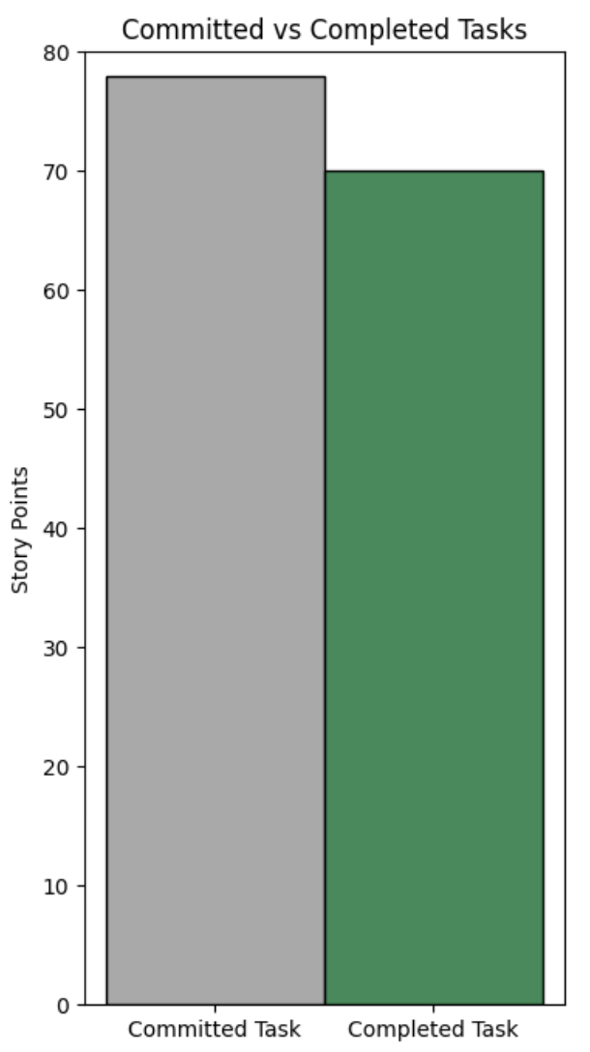
Team Velocity
Sprint 2
Sprint 3
Completed(18)/Committed Ratio(18) : 100%
Average Completed(70)/Committed Ratio(78) : 89.74%

Slide 41
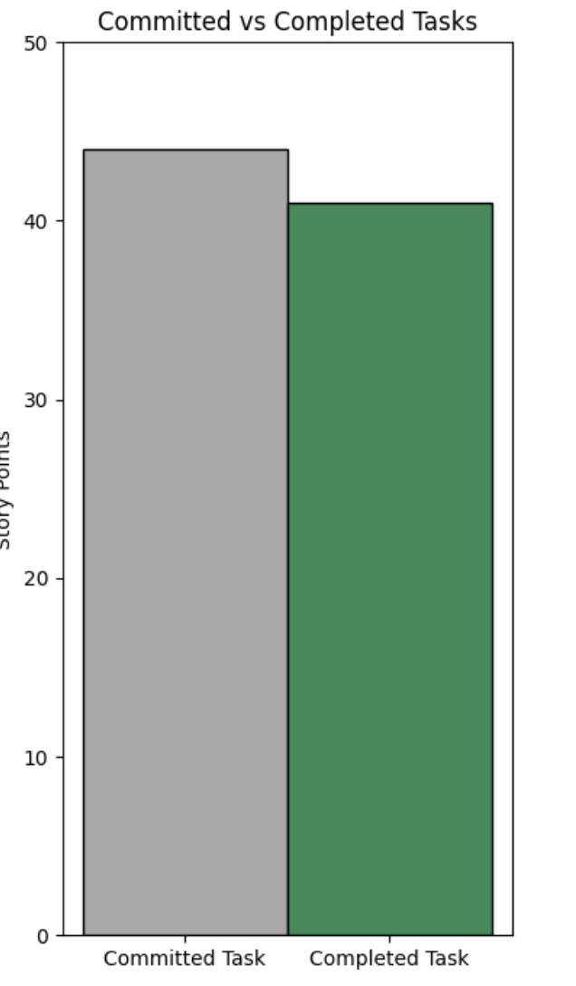
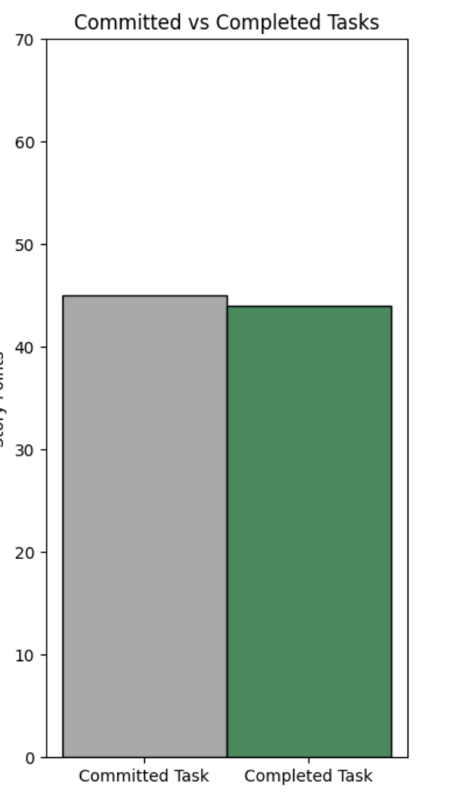
Team Velocity
Sprint 4
Average
Completed(41)/Committed Ratio(44) : 93.18%
Average Completed/Committed Ratio : 97.99%

Slide 42
Burndown Chart
Sprint 2
Sprint 3

Slide 43
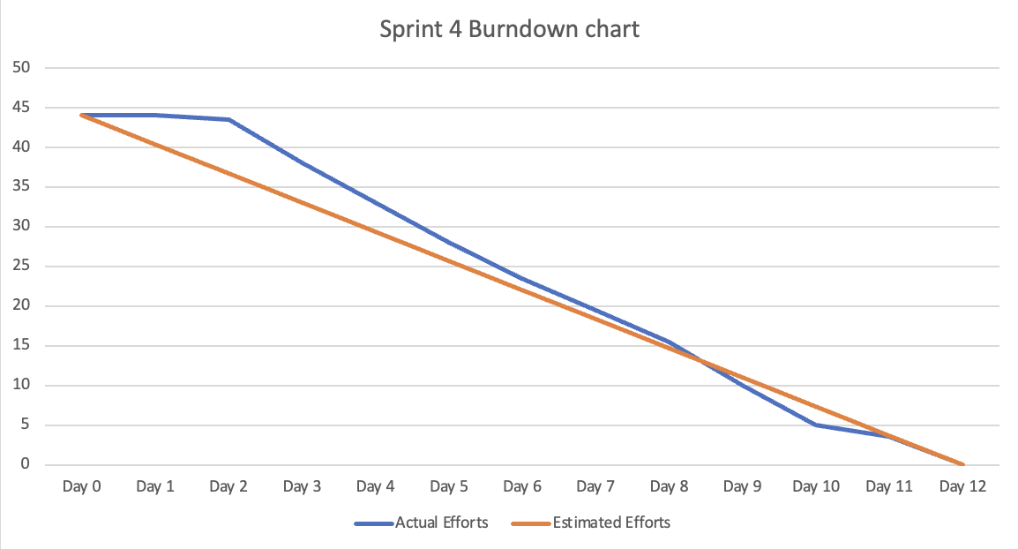
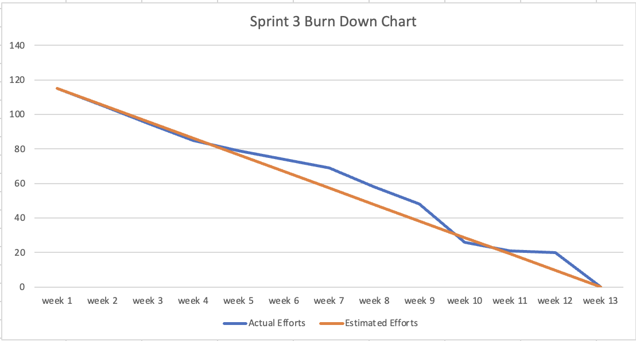
Burndown Chart
Sprint 4
Average

Slide 44
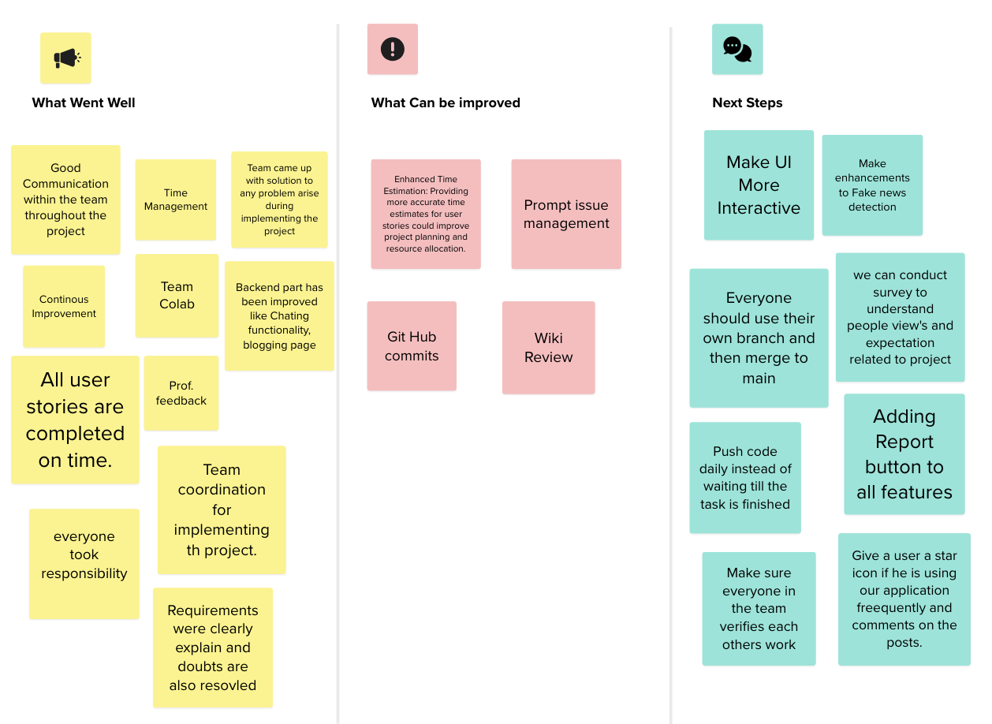
Sprint 4 Retrospective

Slide 45
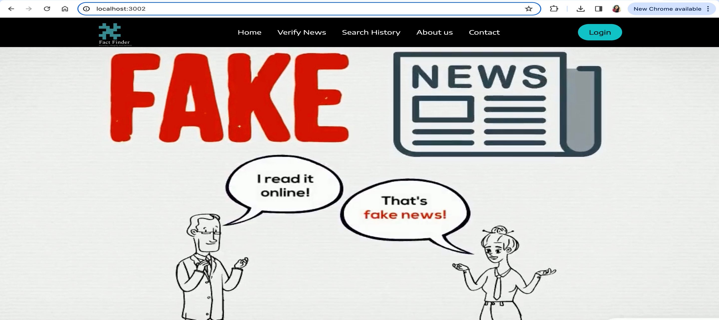
FactFinder website screenshots:

Slide 46
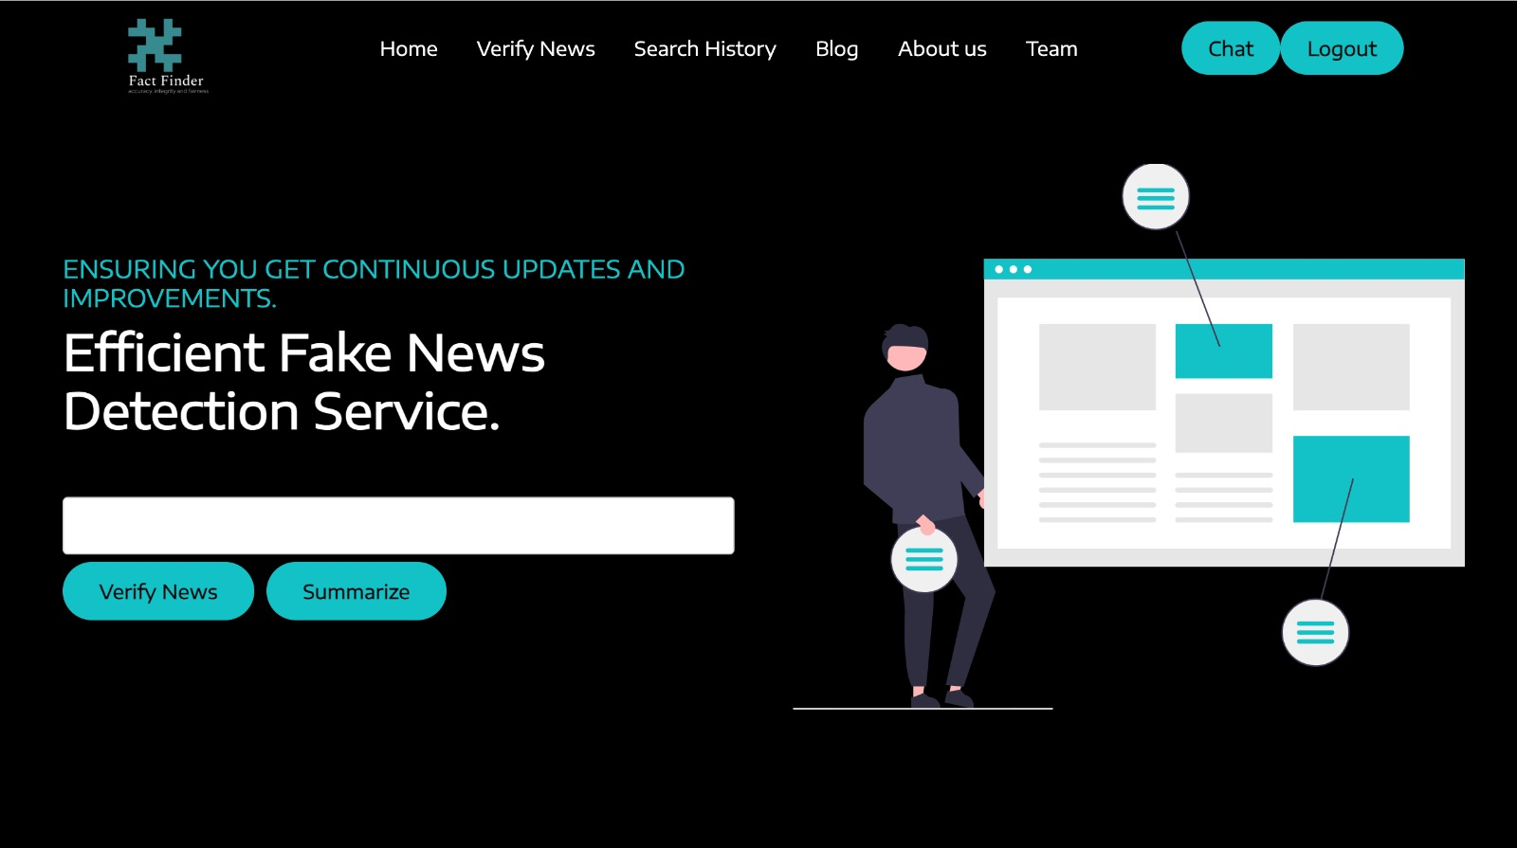
FactFinder website screenshots:

Slide 47
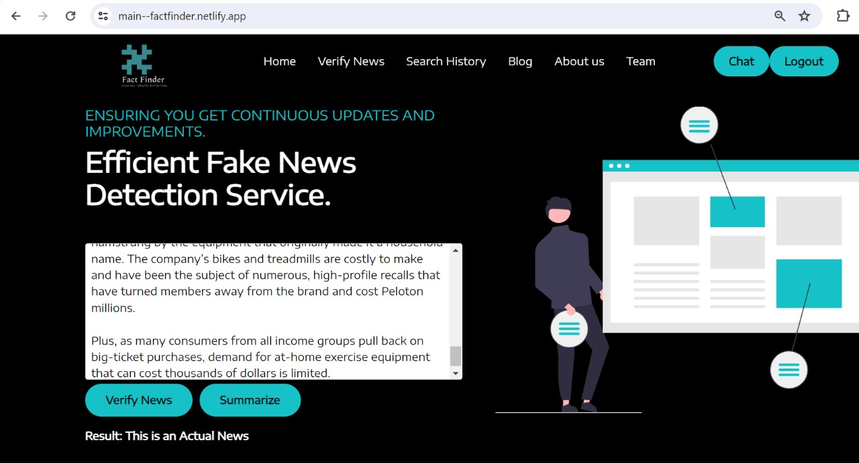
FactFinder website screenshots:

Slide 48
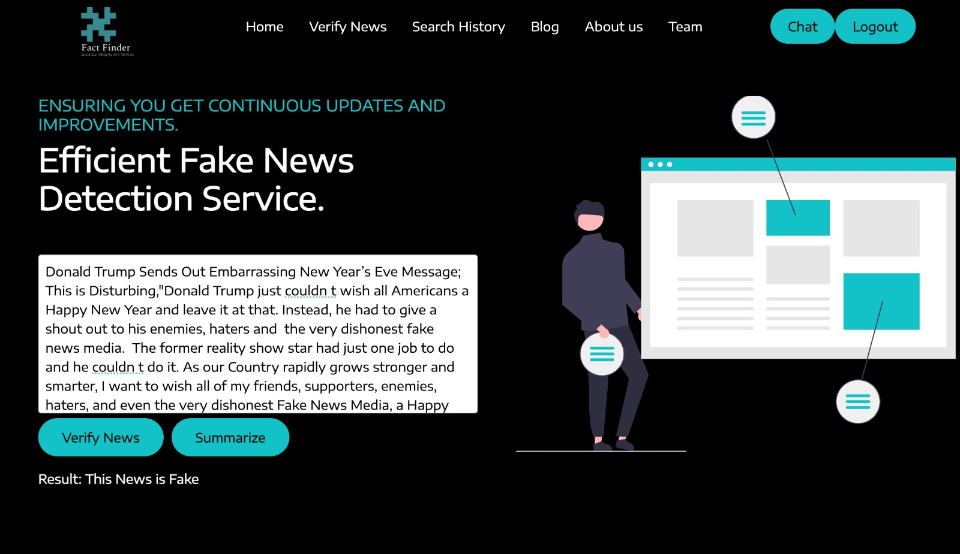
FactFinder website screenshots:

Slide 49
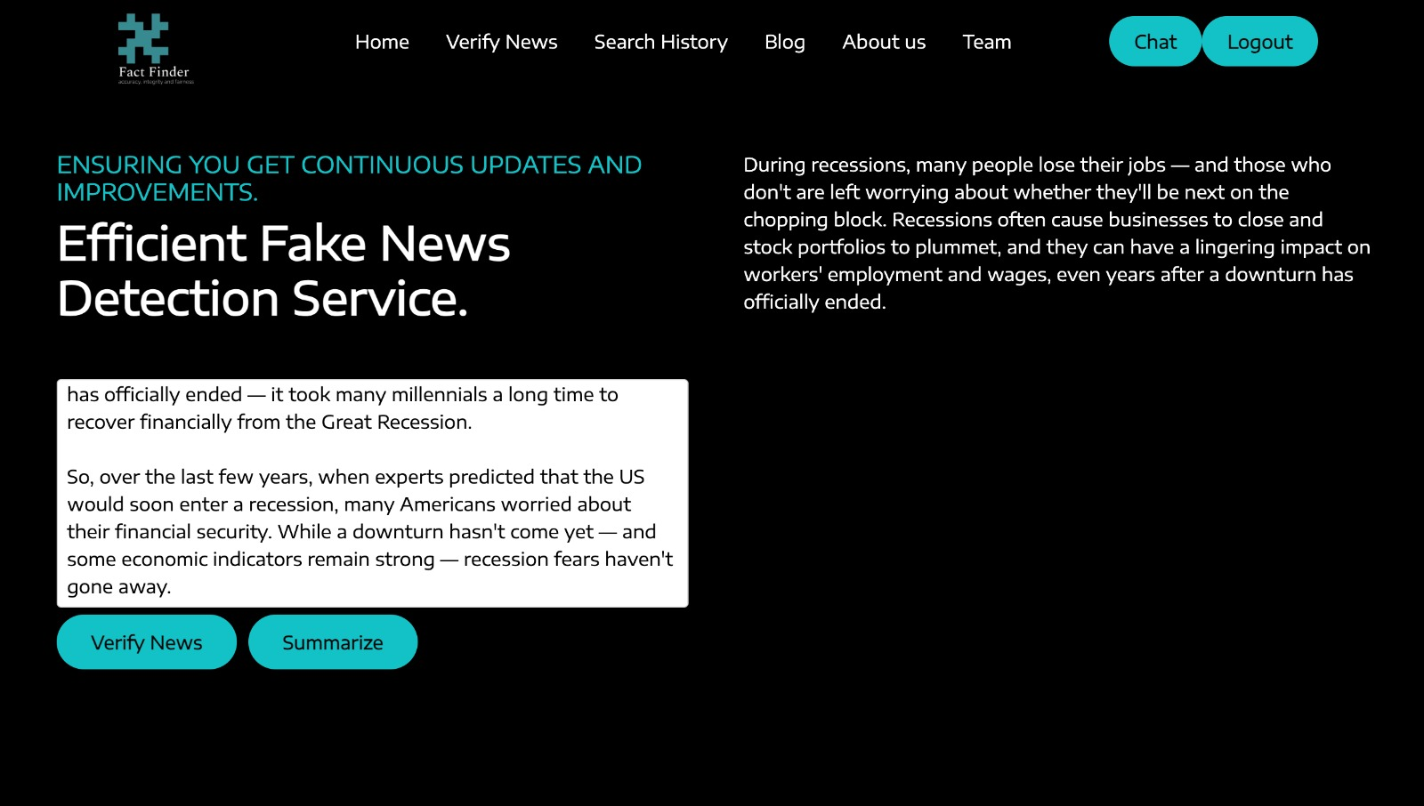
FactFinder website screenshots:

Slide 50
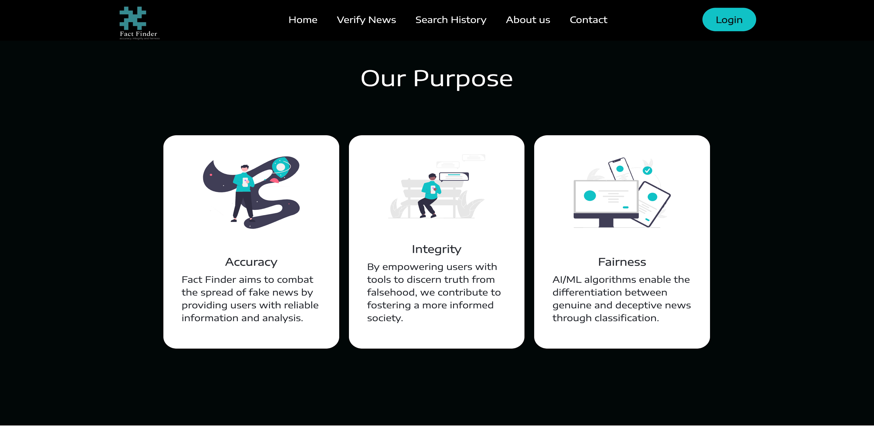
FactFinder website screenshots:

Slide 51
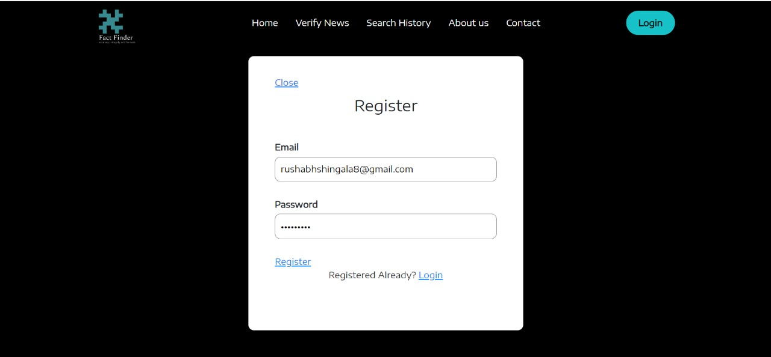
FactFinder website screenshots:

Slide 52

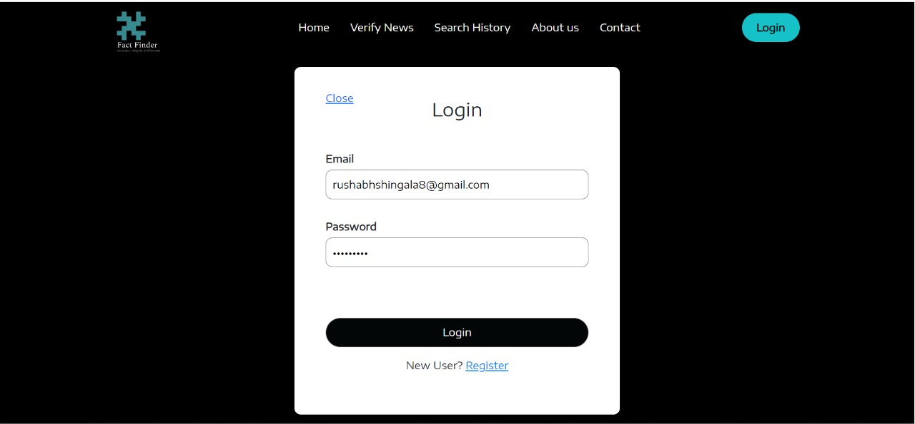
FactFinder website screenshots:

Slide 53
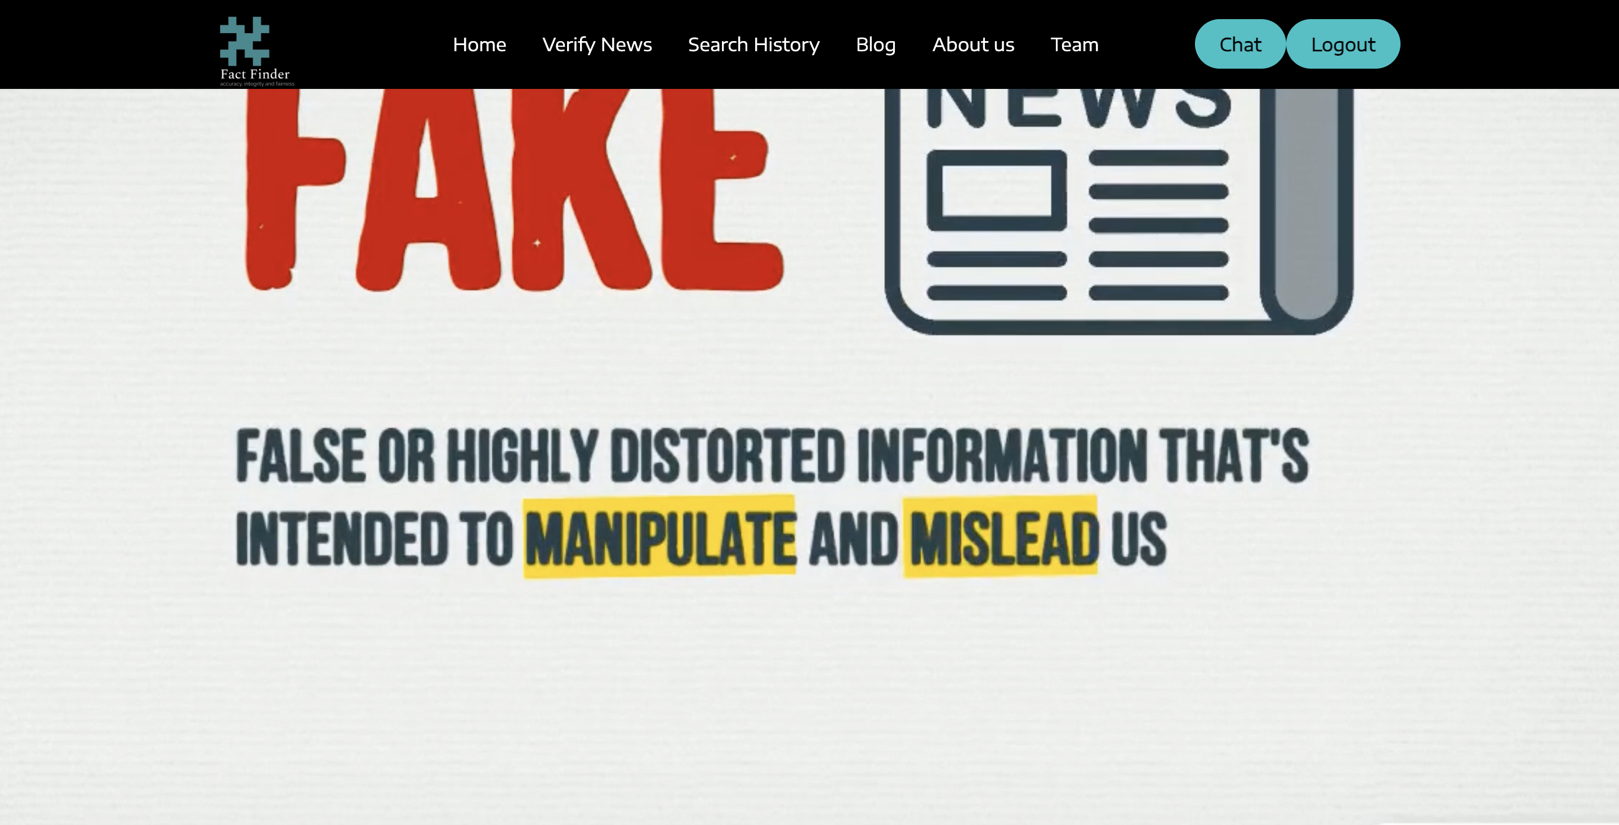
FactFinder website screenshots:

Slide 54
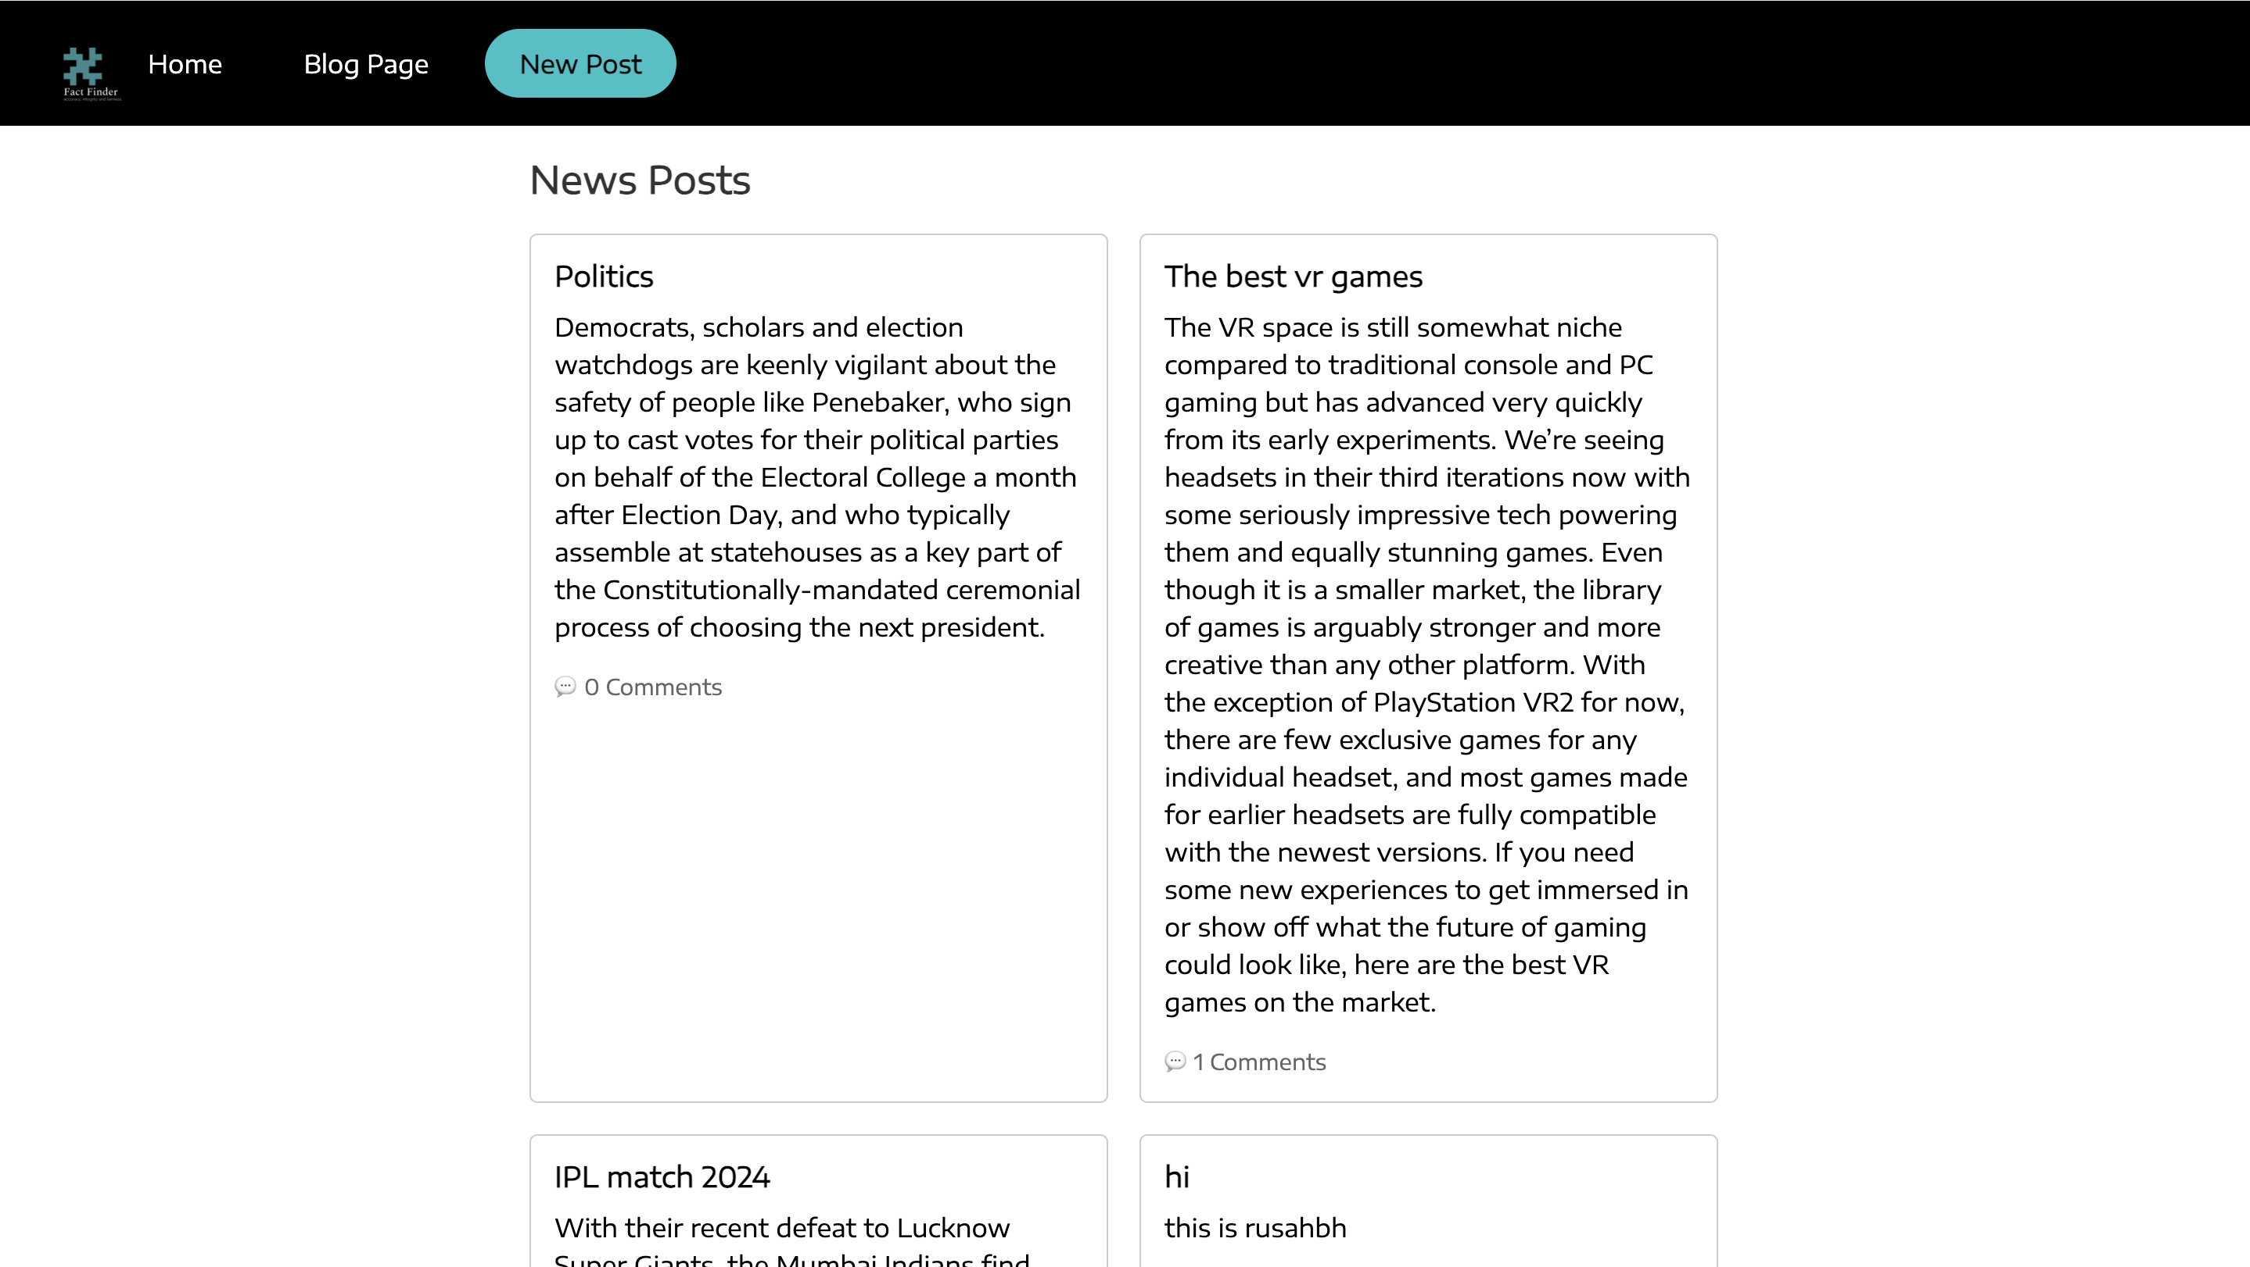
FactFinder website screenshots:

Slide 55
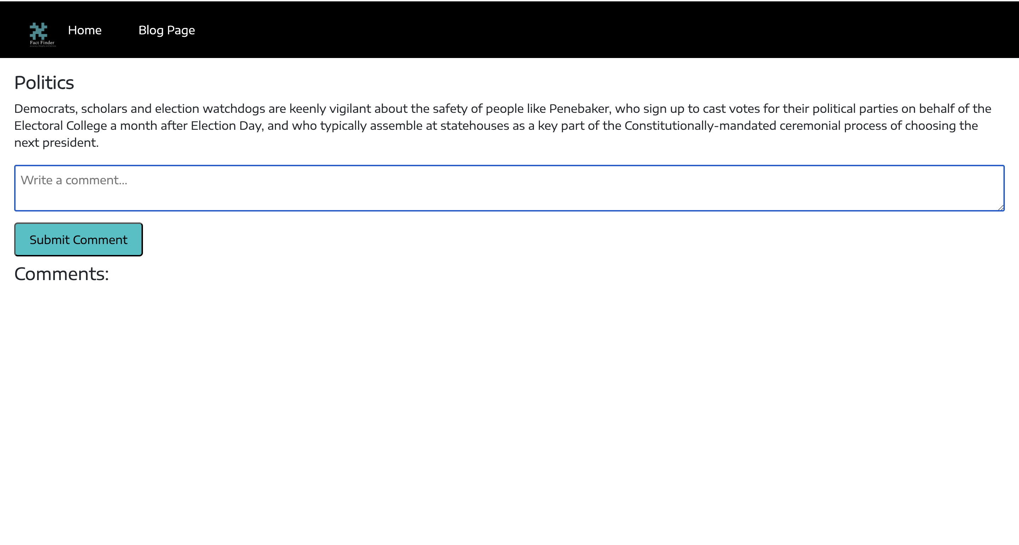
FactFinder website screenshots:

Slide 56
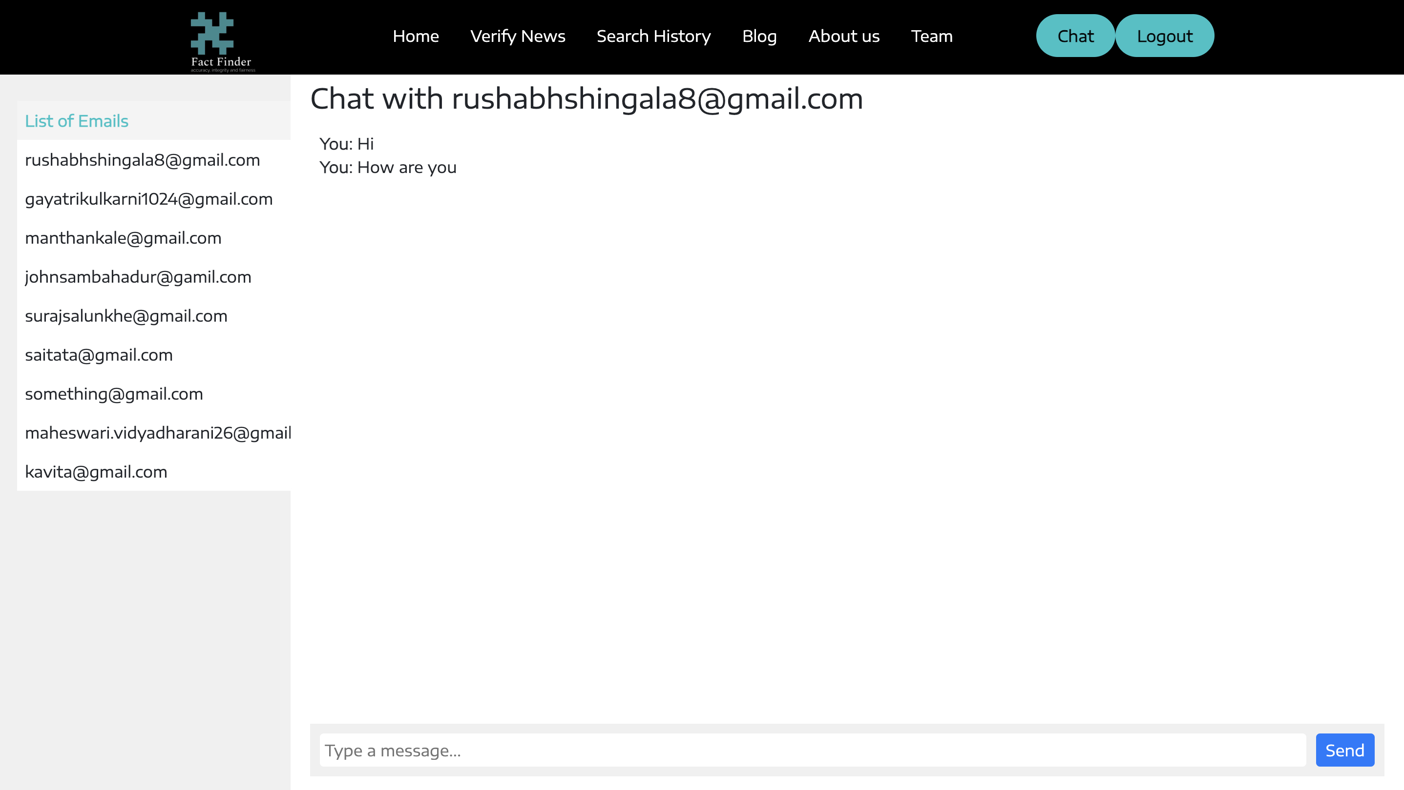
FactFinder website screenshots:

Slide 57
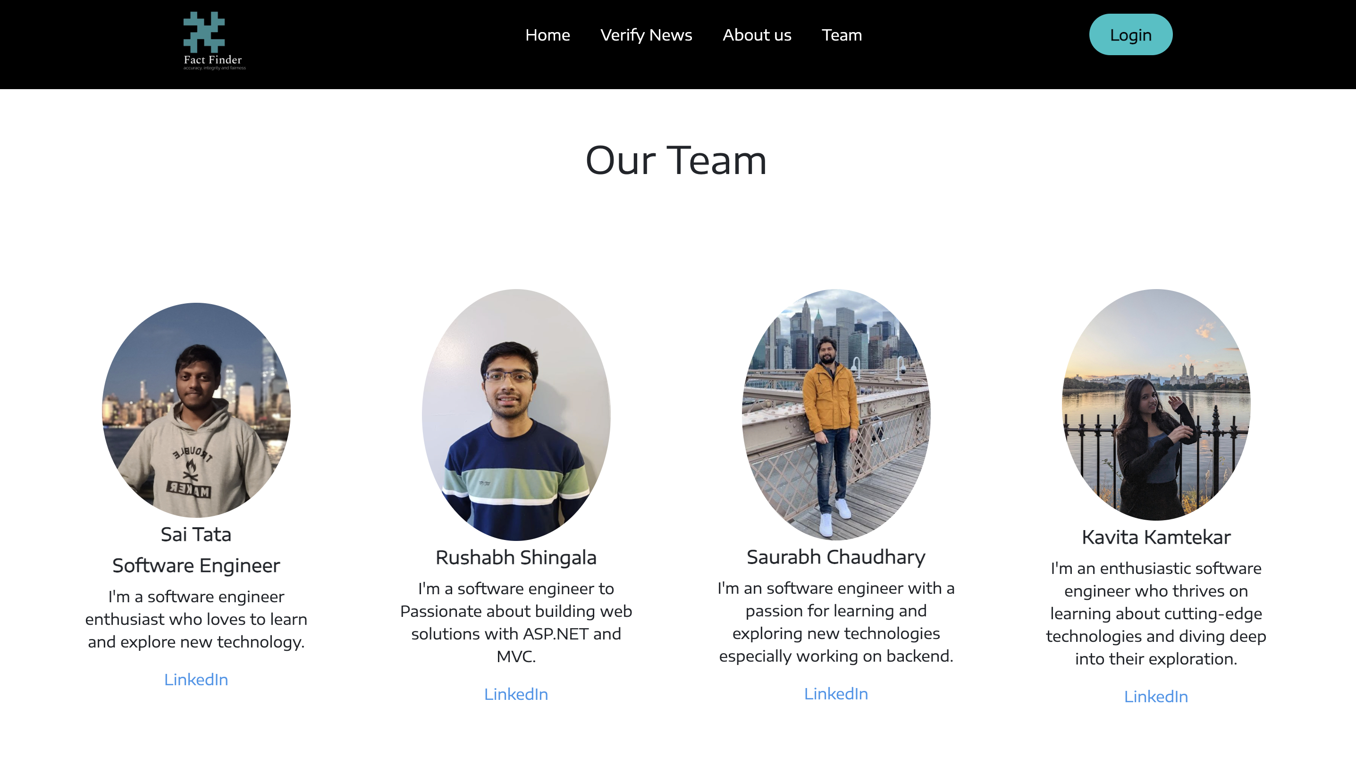
FactFinder website screenshots:

Slide 58
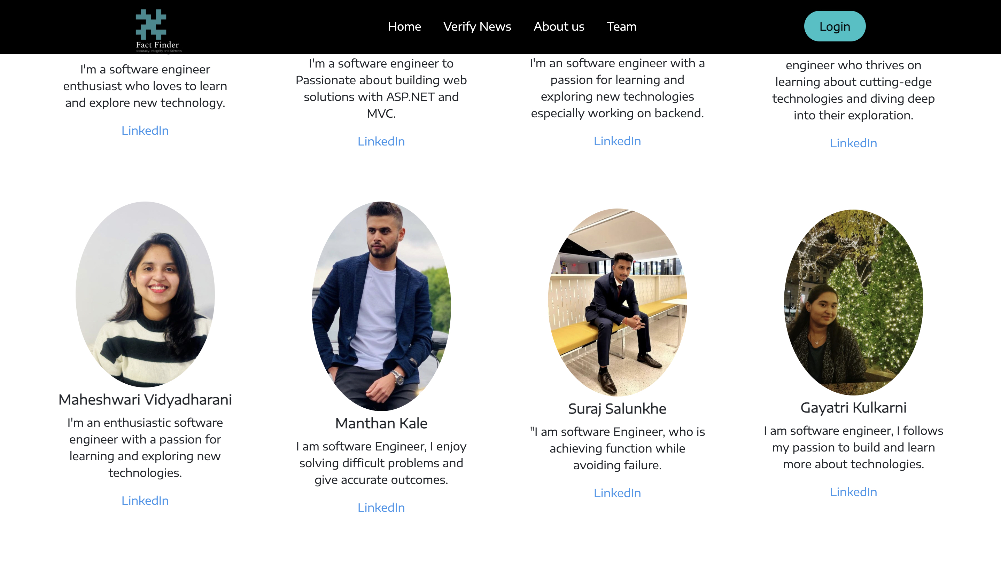
FactFinder website screenshots:

Slide 59
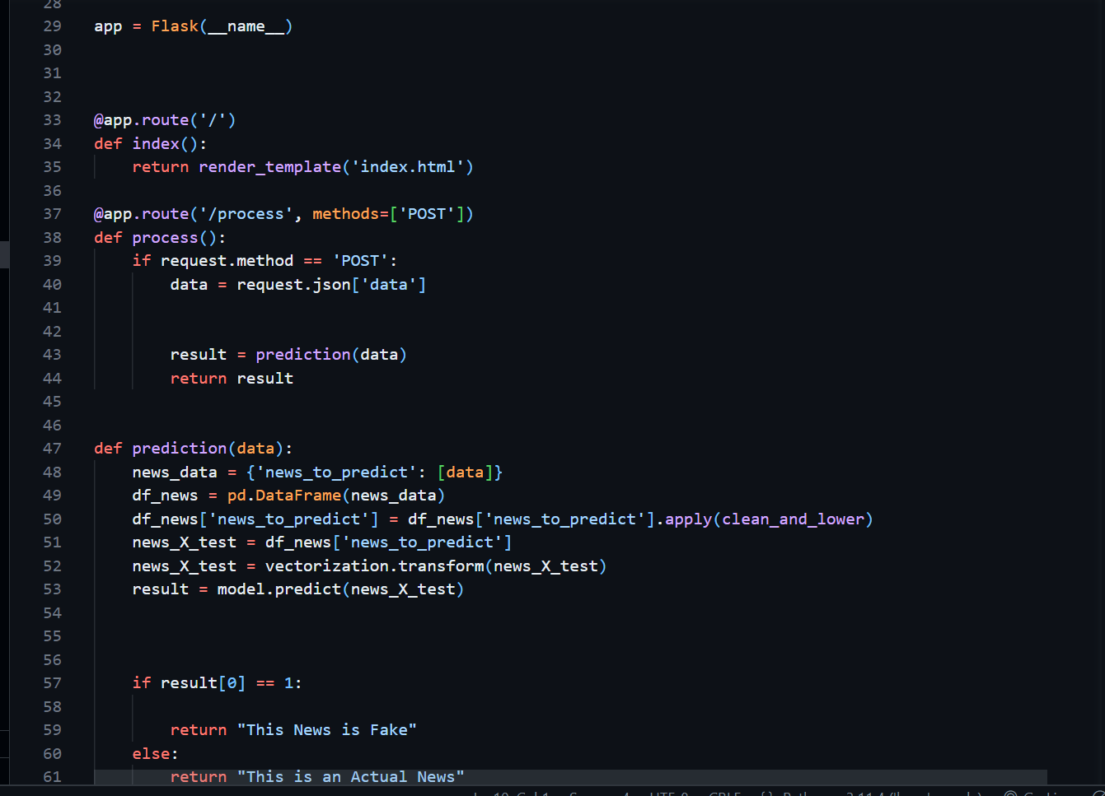
API
We used Flask Framework to create the REST API for our application.
We created three end-points process, summarize and main to return user's POST request.
The process function takes user's input in JSON format, clean the unnecessary words using our clean function, use our trained model and return whether the news is fake or real.

Slide 60
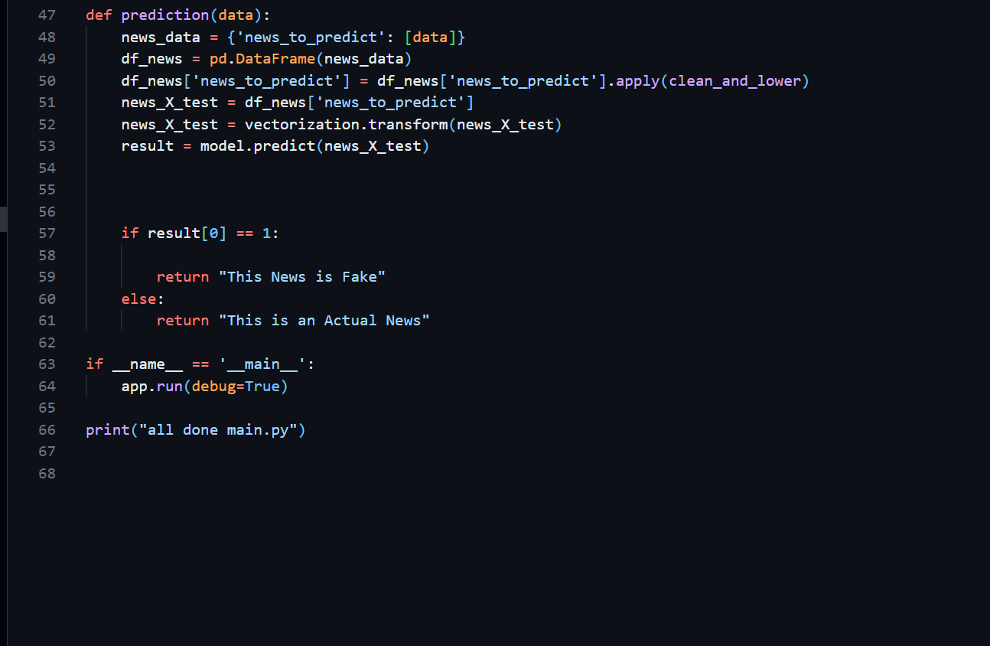
API (Cont..)

Slide 61

API (Cont..)
To create summary out of the news the summarize function take user's input as JSON as an argument. Create input token of the input data.
Generate output token using the pre-trained model.
And decode the output token into text and return to user as JSON format where the JSON format converted back to text using JavaScript.

Slide 62

Git Hub link:
Wiki
https://github.com/htmw/2024S-JusticeLeague/wiki
Source code:
https://github.com/htmw/2024S-JusticeLeague/tree/main/source_code

Slide 63
Live Application Demo Final MVP Demo Link

Slide 64




Thank you
Team Justice League

